Slide 1
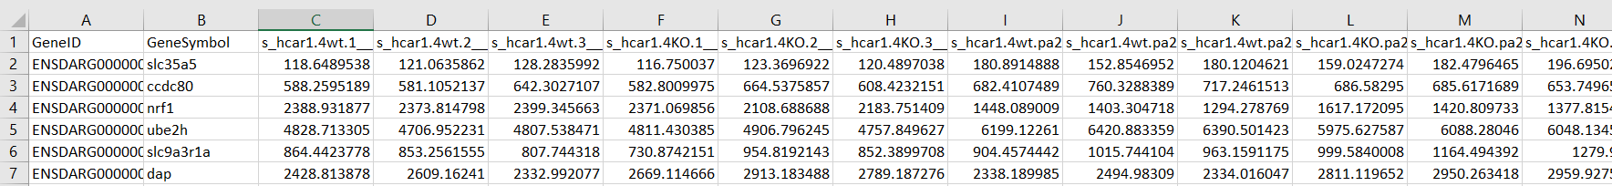
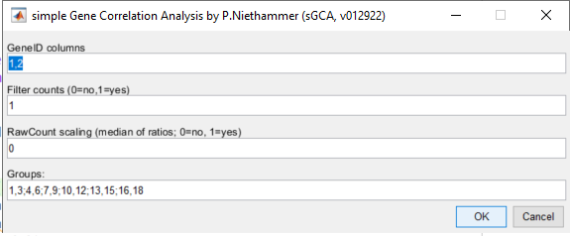
sGCA-input: .xlsx or .csv table with below format
ID columns
Experimental columns
1
2
1
2 3 4 5 6 7 8 9 10 11 12
Group 1: 1-3
Group 2: 4-6
Group 3: 7-9
Group 4: 10-12
genelowvalfilter
generangefilter
genevarfilter
(default MATLAB settings)
Apply medians of ratio normalization
Format: Start column group 1, End column group 1; Start column group 2, End column group 2;etc.

Slide 2

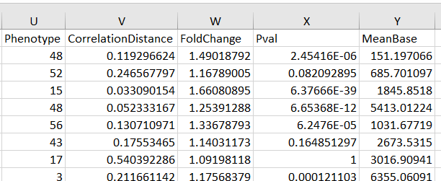
sGCA-output: saved in root directory using timestamp (date time) as unique filename
1) Excel table with IP matrix in first tab and amended count matrix in the second tab:
Fold change between
“1” and “0” IP groups
(recommended cutoff: 2)
IP permutation matrix
Original or processed count matrix with
IP association and stats in last 5 columns
negative binomial model with
Benjamini-Hochberg adjustment
(recommended cutoff: 0.05)
Mean base
(recommended cutoff: 20)
Most similar IP
IP dissimilarity
(i.e., the smaller, the more similar
Recommended cutoff: 0.25)
2) MATLAB file with all workspace variables

